Slide 1

NAME
email@email.com

Slide 2




Team
The experience, track record and vision to succeed.
NAME
Founder & Chief Executive Officer
NAME
Acting Chief CommercialOfficer
NAME
Chief Technology Officer
NAME
Advisor
NAME
Advisor
NAME
Advisor
NAME
Advisor
NAME
Advisor
NAME
Advisor

Slide 3








The Problem
Dining experience is a fragmented process.
Fragmented Booking
Disorganized
No Personalization

Slide 4










Typical Booking
To book a restaurant in Paris, requires many sources to get it done.
Book Flight & Hotel
Research Things to Do
Book Experiences

Slide 5








Powering the World’s Experiences
Our B2C platform enables brands to build and launch best-in-class booking products.
Organized
Bookable
Personalized

Slide 6







COMPANY Solution
To book a restaurant in Paris, visit your preferred brand and book everything in one place.
System automatically filters experiences based on your bookings
Book Restaurant & Hotel
Personalized Offerings
Single Checkout
System communicates in real-time with vendors to ensure availability & pricing

Slide 7
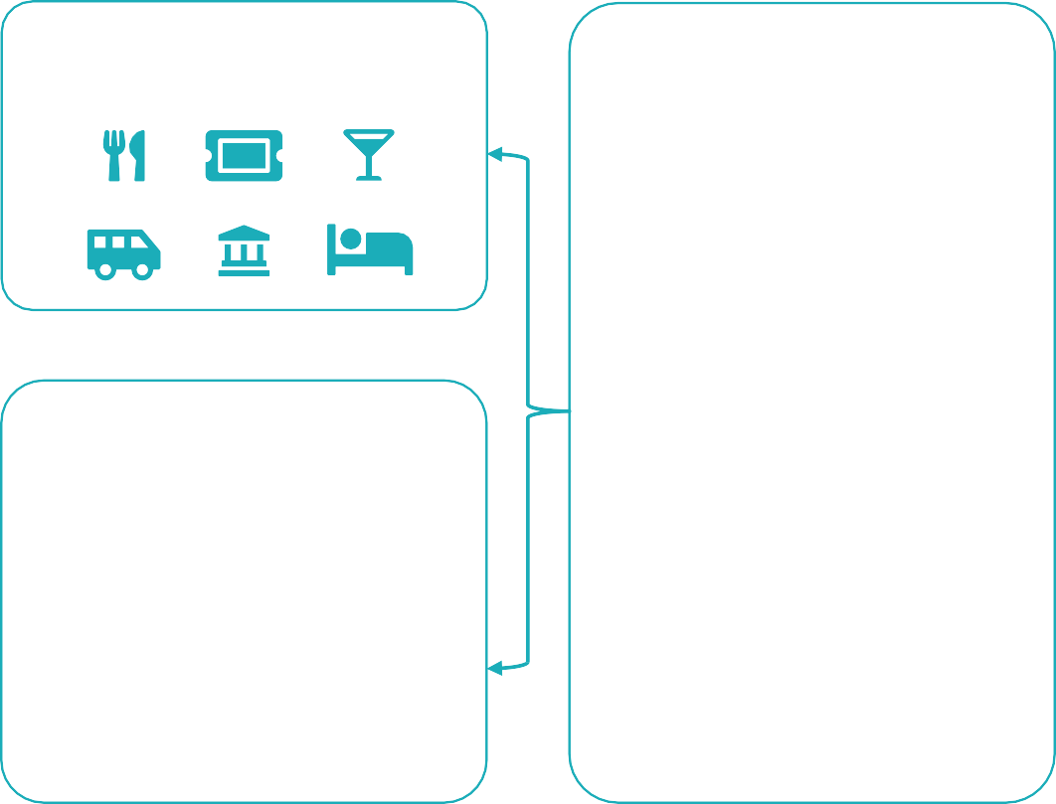






How It Works
Direct Integrations
Simplenight Platform
Demand Partners
Content API
Transaction API
Third-Party Integrations
Personalization API
Scheduling API

Slide 8

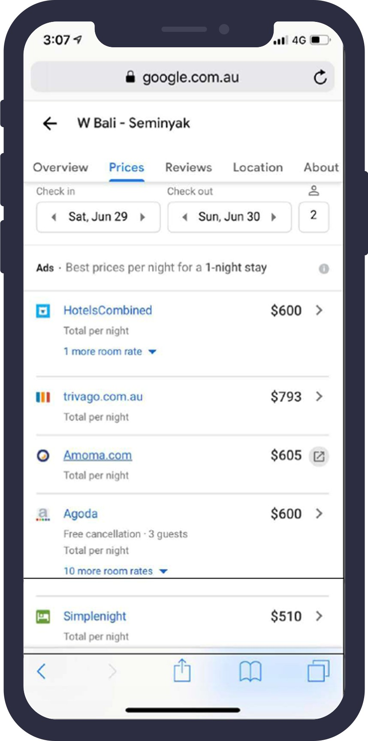
Platform
Our platform can power bookings for any brand.
Travel & Entertainment
Transportation
Search

Slide 9





What About COVID-19?
We continue to grow during the pandemic.
579%
12
562%
$5B+

Slide 10
Traction
We continue to make great progress.
1.8 Months
Sales Cycle
$1.8M
2020 ARR
1.5M+
Bookable products
$4K
Partner Acquisition Cost
$5.3M
2021 Projected ARR
2,000+
Cities
$4.5M
Partner Lifetime Value
250%
Annual Growth
170+
Countries

Slide 11










Partners
We are actively onboarding new brands.

Slide 12


A Global Opportunity
Powering the world’s experiences has unlimited potential.
$2 T
$3T
World
$165B
Passenger Economy Market

Slide 13

Business Model
Our business model is structured around licensing and transaction fees. As merchant of record, we control payment to partners and suppliers.
Licensing Fee
Partner pays a recurring fee to use the platform.
Transaction Fee
Partner pays a fee for every sale.

Slide 14
Industry Landscape
Most companies focus on a B2C experience. As a B2B platform, we focus on providing the best content and booking technology for demand partners.
Robust Tech
No Content
Vast Content
Basic Tech

Slide 15
Market Strategy
Industries are leveraging robust middleware solutions to power great customer experiences.
COMPANY 1 LOGO
COMPANY 2 LOGO
COMPANY 3 LOGO
eCommerce
Powering the eCommerce Industry
Communication
Powering the Communication Industry
FinTech
Powering the FinTech Industry

Slide 16


Exit Strategy
There are several ideal acquirers for NAME.
Existing partner and adds to core through acquisitions
Could expand into the experience business overnight
History of acquiring industry- leading booking platforms

Slide 17
The Ask
We are raising $2.5M
to launch new partners, scale the business and reach profitability.
G&A
Milestones
Infrastructure
5%
10%
Partner Integrations
Grow Team
Customer Support
10%
Enhance Product
Use of Proceeds
50%
Expand Supply
Headcount 25%
Launch New Partners
Reach Profitability

Slide 18
NAME
name@email.com

